Slide 1

Knowledge-guided machine learning model with soil moisture for corn yield prediction under drought conditions
Xiaoyu Wang
Advisor: Dr. Zhou Zhang
03/19/2025
Notes:
Hi everyone, I'm Xiaoyu Wang, a third year phd student advised by Dr Zhou Zhang.
Some of you may have seen my presentation the last year. this year we have some new research
The title is Knowledge-guided machine learning model with soil moisture for corn yield prediction under drought conditions

Slide 2

Outline
Corn yield prediction: data, method and model
Knowledge-guided machine learning (KGML)
Why, what, and how
How KGML solves problems in our task
Our method:
Data acquisition: two datasets
Methodology: KGML with soil moisture model (KGML-SM)
Experiment result
Analysis
Notes:
In the first section, we'll introduce the background of corn yield prediction, the data, method, and model

Slide 3

Crop yield prediction: motivation
In the Sustainable Development Goals, zero hunger is ranked second.
800 million people still live without an adequate food supply.
By 2050, there will be two billion more people to feed.
Notes:
The motivation of corn yield prediction is hunger and food shortage. This figure shows the 17 sustainable development goals, we can see the zero hunger ranks second.
And there are two statistics. First, 800 million people still live without an adequate food supply.
second, By 2050, there will be two billion more people to feed.

Slide 4
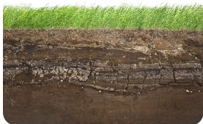



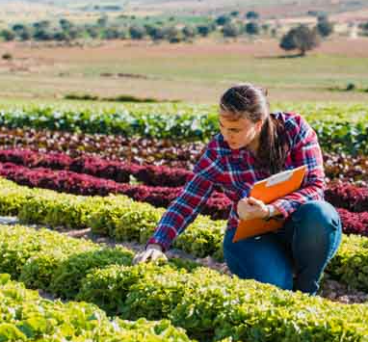
Traditional process-based model
Process-based model:
A mathematical representation of a cropping system that simulates crop growth based on environmental conditions and management practices.
Soil characteristics
Climate
Output:
Crop yield
Biomass
...
Crop model
Plant parameter
Crop management
Notes:
Here I'll introduce the general methods of crop yield prediction.
the first the traditional process-based model.
It is a mathematical representation of a cropping system that simulates crop growth based on environmental conditions and management practices.
Look at this figure, we first initialize the model, then input some soil characteristics, climate data, plant parameters, and crop management. Finally we can get the output, like crop yield, biomass, etc

Slide 5
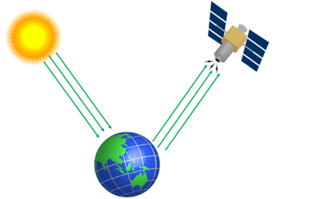
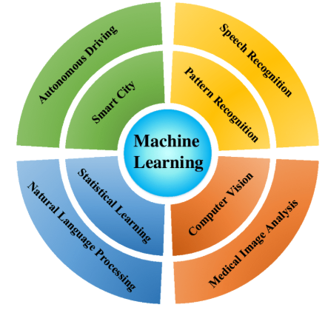
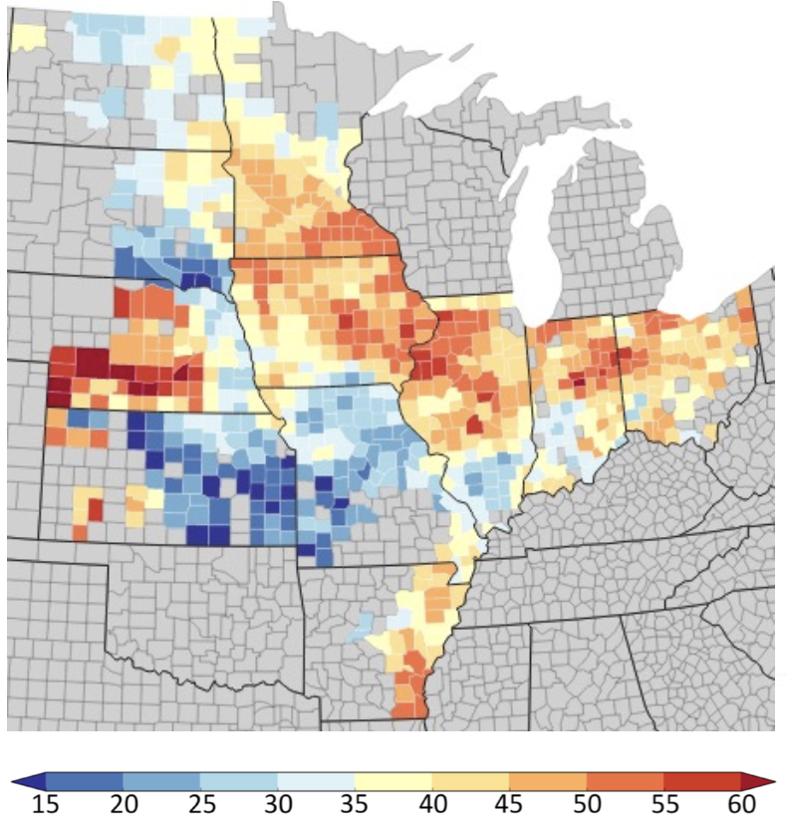
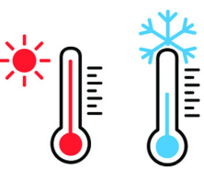

Modern learning-based model
Learning-based method:
use different agricultural data and machine learning models to predict crop yield.
Satellite imagery
Temperature
Crop yield map
Precipitation
...
Notes:
And the other method is the learning-based model.
It use different agricultural data and machine learning models to predict crop yield.
Look at this figure, we first collect different kinds of data, …. then input these data to a machine learning model, finally we get the crop yield.

Slide 6
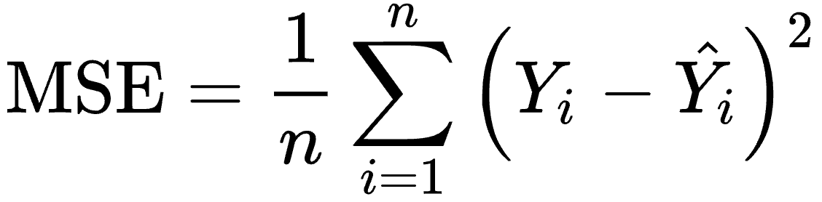
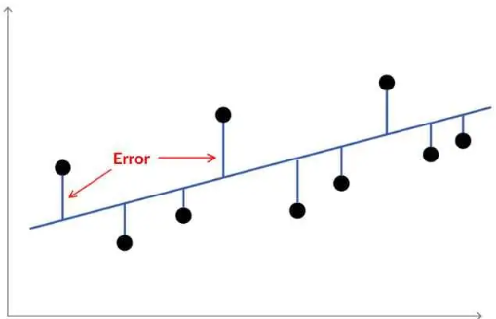
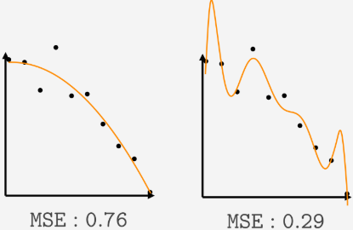
What is machine learning (ML)?
Machine learning is a function, which maps an "instance" to its "label".
Label = Function (instance).
In our task, the function is: Corn yield = Function (features).
In the figures, one point has a pair of property (features, yield), and the line is the learned machine learning model.
Loss function:
The loss function helps 'push' the model to fit the data and minimize the error. The larger the loss, the stronger the push.
Error
Notes:
Now we need to introduce, what is ML.
ML is like a function, which maps an "instance" to its "label", like label is equal to function of instance.
So in our corn yield prediction task, it's like corn yield is equal to function of features.
Look at the left figure, one point is just one data, and this line is the learned ml model. We try to fit the line to these data by the loss function.
What is loss function? The loss function can 'push' the model to fit the data and minimize the error. The larger the loss, the stronger the push.
Here we use the mse loss function, which represents how far our predictions are from the actual values.
Look at the right figure, the first line is not fitting well to these data, the MSE loss function is bigger, so it will push the line to fit better.
And the second line is fitting the data well, so the MSE loss function is small.

Slide 7
Outline
Corn yield prediction: data, method and model
Knowledge-guided machine learning (KGML)
Why, what, and how
How KGML solves problems in our task
Our method:
Data acquisition: two datasets
Methodology: KGML with soil moisture model (KGML-SM)
Experiment result
Analysis
Notes:
In the second section, we'll talk about KGML.
Why use it, what is it, and how to use it.

Slide 8
Why Knowledge-guided machine learning?
Trade-off of learning-based and process-based model.
How to combine:
knowledge-guided machine learning (KGML).
Process-based model | Learning-based model
Don't require a big training dataset Easy controlled and debuggable Transparent | Don't need knowledge Easy to scale
Hard to cover all the domain knowledge Need to adjust parameters in every place | Require large training dataset Difficult to debug No interpretability
Notes:
Let's see why we need KGML.
Because we can see here is a trade-off between learning-based and process-based model.
...
So that's why we need to combine them, which is kgml.

Slide 9
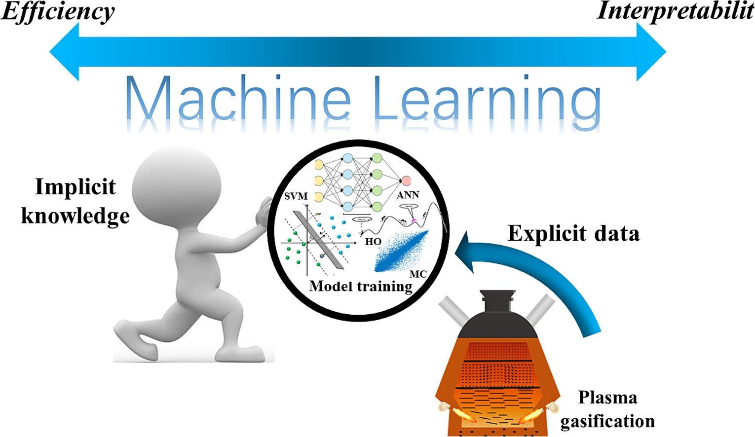
What is Knowledge-guided machine learning?
KGML:
Encode some human knowledge into ML model.
y
Notes:
So what is kgml?
Look at this figure, we get some data to train a ml model, and we can encode some human knowledge into the model.
By this way, it can balance the efficiency and interpretability.

Slide 10
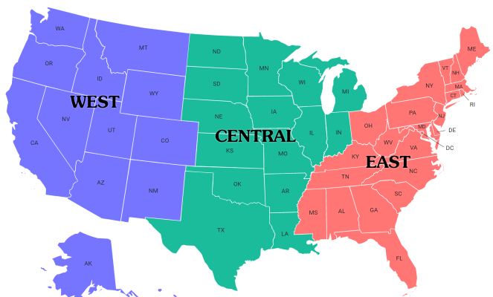
How to perform KGML: pretrain-finetune
"Pretrain" ML model with data simulated by process-based model, then "finetune" it with real data.
Example: predict corn yield in the Eastern U.S.
We have a model "pretrained" in Western U.S. Since conditions differ,
we need to "finetune" the "pretrained" model on Eastern data for better accuracy.
Pretrain with simulated data
Pretrain in West
Finetune in East
Finetune with real data
Notes:
Then we introduce how to do it? There is a paradigm called pretrain-finetune.
We can pretrain the ml model with data simulated by process-based model, then finetune it with real data.
So what is pretrain and finetune?
I'll take an example, suppose we want to predict corn yield in the east.
And we alrealy have a model pretrained in west, but we can't just apply it directly to the east. Because conditions are different.
So we need to finetune the model in east to make it suitable for the local condition.

Slide 11
Outline
Corn yield prediction: data, method and model
Knowledge-guided machine learning (KGML)
Why, what, and how
How KGML solves problems in our task
Our method:
Data acquisition: two datasets
Methodology: KGML with soil moisture model (KGML-SM)
Experiment result
Analysis
Notes:
Next we'll talk about how to use KGML to solve the problem in corn yield prediction

Slide 12
Problem 1 and solution
Problem 1:
ML models often struggle to capture complex relationships between environmental data and corn yield.
Solution:
Pretraining with simulated data: Process-based models are good at simulating the impact of environmental condition on crop growth, eg: weather —> soil —> crop yield.
Pretrain:
ML model 1
Simulated
Soil moisture
ML model 2
Simulated
crop yield
Weather
Finetune:
ML model 1
ML model 2
Weather
Real
Soil moisture
Real
crop yield
Notes:
the first problem is, ML models often struggle to capture complex relationships between environmental data and corn yield.
So the solution is, we can pretrain the ml model with simulated data, by this way, we can encode the knowledge of process-based model into the ml model.
For example, there is a complicated process, from weather condition, to soil moisture, to crop yield. How to learn it?
First we pretrain the ml model with simulated soil moisture and crop yield, which can encode some knowledge into the model.
Second we finetune the ml model with real soil moisture and crop yield, which can make the model accurate.

Slide 13
Problem 2 and solution
Problem 2:
Limited real soil moisture data only from 2015.
Solution:
Simulated Data could be used to pretrain the ML model.
Pretrain:
ML model 1
Simulated
Soil moisture
ML model 2
Simulated
crop yield
Weather
Finetune:
ML model 1
ML model 2
Weather
Real
Soil moisture
Real
crop yield
Notes:
Here is the second problem.
The soil moisture data is only from 2015. But our ml model needs big dataset.
The solution is we can simulate some soil moisture data by process-based model.

Slide 14
Outline
Corn yield prediction: data, method and model
Knowledge-guided machine learning(KGML)
Why, what, and how
How KGML solves problems in our task
Our method
Data acquisition: two datasets
Methodology: KGML with soil moisture model (KGML-SM)
Experiment result
Analysis
Notes:
In the third section, we'll introduce our method

Slide 15
Dataset overview: study area and data source
Two datasets in U.S. corn belt: simulated and real
Simulated dataset: APSIM field-level dataset from process-based model (APSIM)
Real dataset: GEE county-level dataset from Google Earth Engine (GEE)
Notes:
So the first dataset is a simulated dataset, which is the APSIM field-level dataset, from a process-based model APSIM
And the second is a real dataset, which is the GEE county-level dataset from google earth engine.
This our study area, 12 states in the us corn belt.

Slide 16
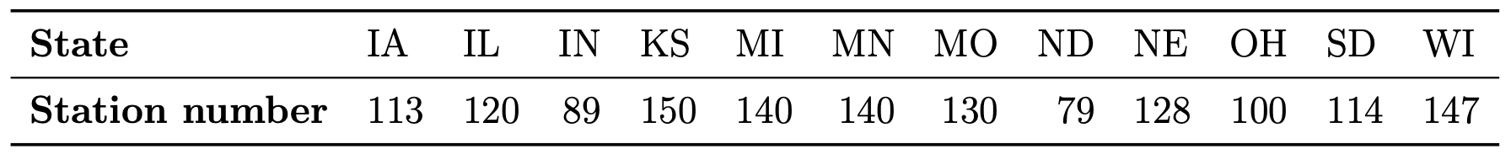
APSIM simulation setup
Simulation area: 12 states in the US
North Dakota, South Dakota, Minnesota, Wisconsin, Iowa, Illinois, Indiana, Ohio, Missouri, Kansas, Nebraska and Michigan.
Year:
2000-2023.
Data point:
around 1000 stations in 12 states.
Notes:
First we'll introduce the APSIM model simulation setup.
The simulation area is 12 states.
And the time is from 2000 to 2023.
And the data point is around 1000 stations in 12 states.

Slide 17
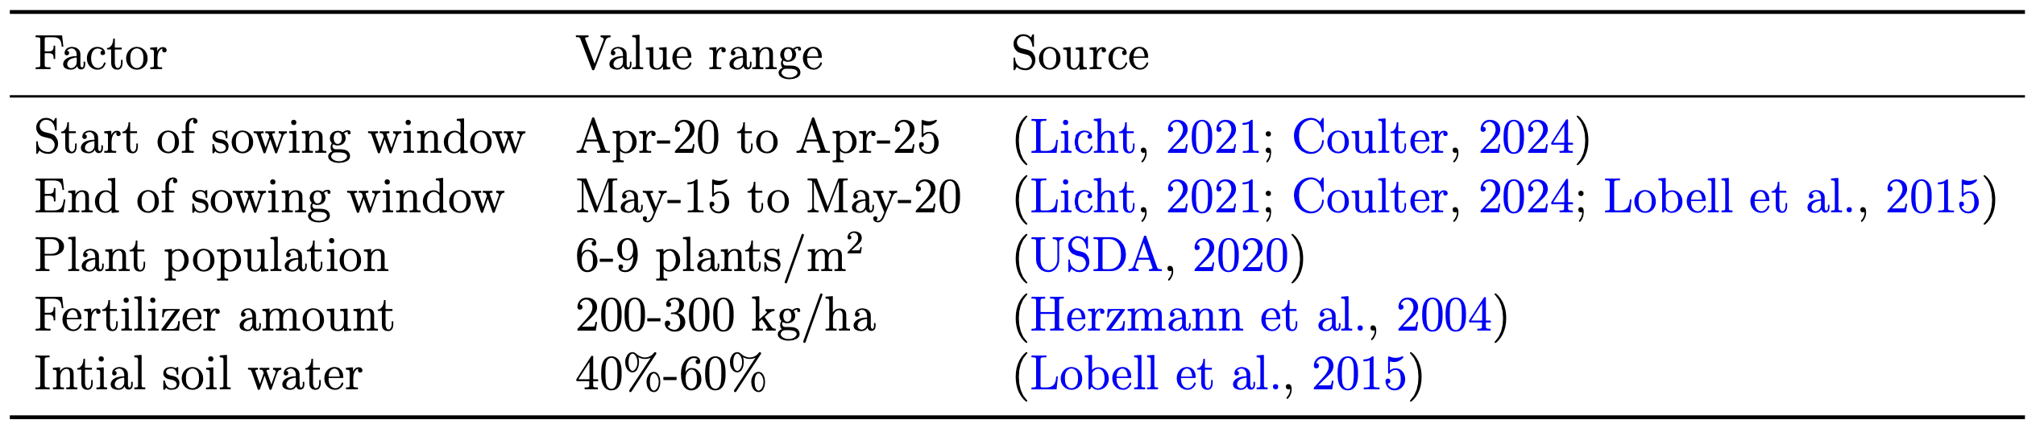
APSIM management parameters
Yield-sensitive management parameters: There are hundreds of management parameters here, but these are the ones I've found to be the most important.
Notes:
We also need some management parameters for APSIM simulation.
There are hundreds of parameters but I only choose some important. Like ...

Slide 18
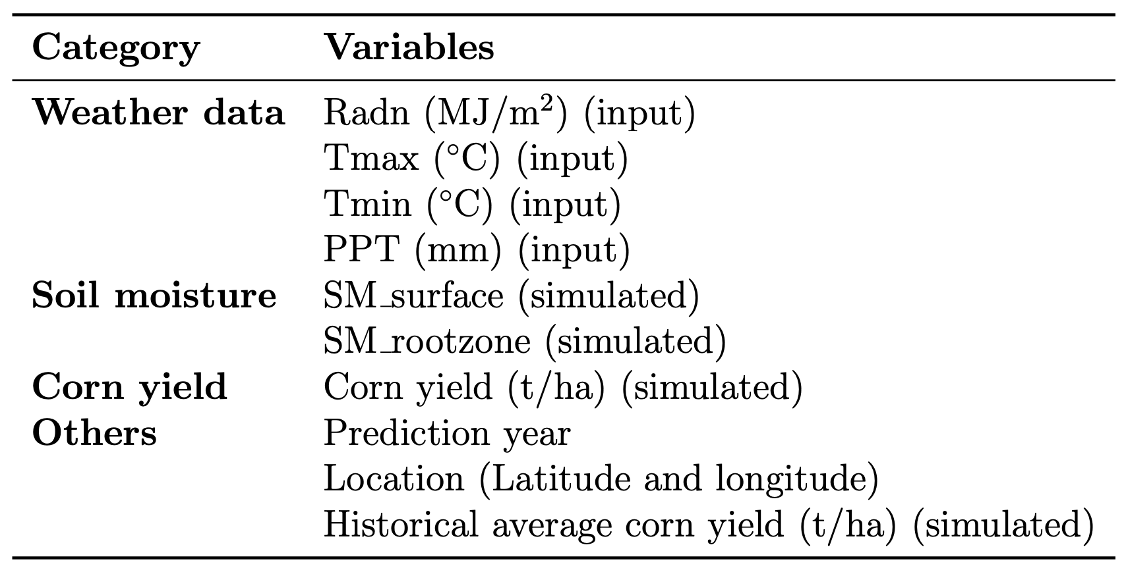
APSIM field-level dataset variables
All the variables of APSIM field-level dataset
Notes:
This is the overview of all the variables in our simulated dataset.

Slide 19
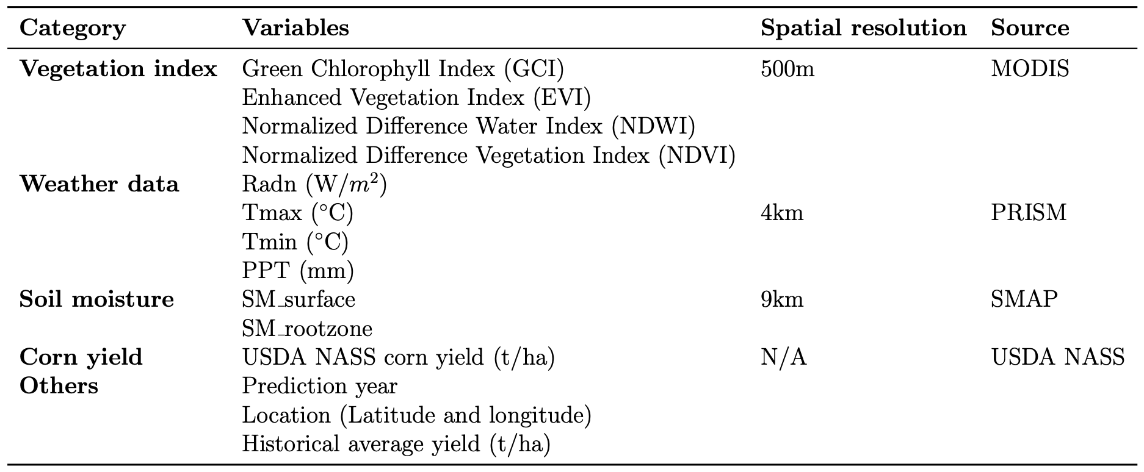
GEE Couty-level dataset variables
Year: 2015-2023
All the features are county-level, 16-day interval
Notes:
This is our second dataset, the real dataset, GEE county-level dataset.
The time is from 2015 to 2023.
We add some new types of data, the VIs from satellite imagery.
And all other variables are the same as our first dataset.
The difference is they are real, not simulated.

Slide 20
Outline
Corn yield prediction: data, method and model
Knowledge-guided machine learning (KGML)
Why, what, and how
How KGML solves problems in our task
Our method
Data acquisition: two datasets
Methodology: KGML with soil moisture model (KGML-SM)
Experiment result
Analysis
Notes:
Then we introduce our methodology, our KGML with soil moisture model

Slide 21
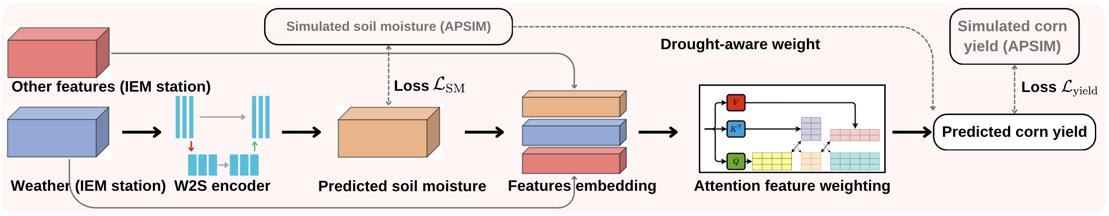
Weather-to-soil (W2S) encoder
Weather-to-Soil (W2S) encoder:
The role of the W2S encoder is to learn the process from weather to soil moisture.
Input: weather data.
Output: soil moisture.
Notes:
The first component is a weather-to-soil encoder. It can learn the process from weather to soil moisture.

Slide 22
Attention module
Attention module:
It can weight different input features and output the corn yield.
Input: concatenated variables feature.
Output: Corn yield.
Notes:
The second component is the attention model, which can weight different input features and output corn yield.
The input is the concatenated variables.
The output is corn yield.

Slide 23

What is Attention?
The attention mechanism functions similarly to how humans focus on specific parts of their environment.
Example:
When you are in a classroom, you need to assign more "weight" to the teacher.
Attention!
A classroom
Notes:
Then we'll introduce what is attention. The attention mechanism in ml is like human focus on some parts of environment.
For example, now we are in the classroom, so most of your attention will be focusing on me, which means, which means you assign more weights to me.

Slide 24
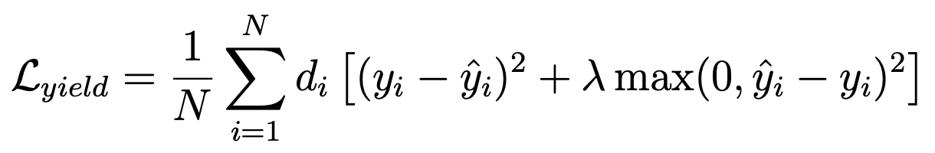
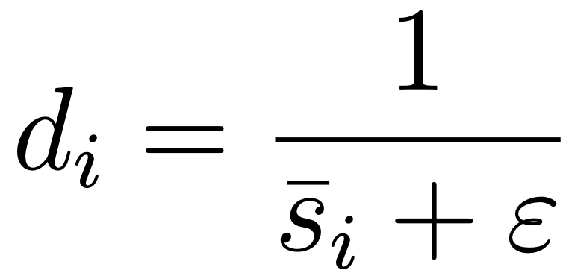
Drought-aware loss function
Phenomenon: drought leads to yield overestimation.
Drought-aware loss: The purpose of this loss is to enhance the model’s prediction in drought-affected areas and reduce overestimation.
Notes:
This is the third component of our model, the drought aware loss function, which can make the model accurate and reduce yield overestimation in drought.
The equation is so complicated, but don't worry

Slide 25
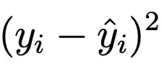
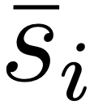
How does drought-aware loss function work?
Remember what is loss function:
The loss function helps 'push' the model to fit the data and minimize the error. The larger the loss, the stronger the push.
Basic MSE loss function:
Drought-aware weighting:
As drought increases, soil moisture decreases, which causes 𝑑 to increase. As a result, the loss becomes larger, pushing the model to be more accurate.
is soil moisture.​
Notes:
I'll take it apart.
Let's go back to remember what is a loss function? It can push the model to fit the data. The larger the loss, the stronger the push.
Let's see the red dash line.
This part is a basic mse loss function, it can push the model's predicted corn yield to be the same as the actual corn yield.
And this part, the d, is a drought aware weighting term.
Let's see how it works. The drought increases, the soil moisture decreases, the d increases, the loss increases, so it will push the model to be accurate.

Slide 26
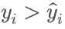
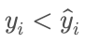
How does drought-aware loss function work?
Asymmetric penalty:
When , there is no extra penalty, this term will be zero, and the model learns from the standard MSE loss.
When , an additional penalty is applied, increasing the loss.
Therefore, the model can reduce overestimation, leading to more conservative predictions, especially in drought-affect areas.
Notes:
And this part is an asymmetric penalty.
Let see how it works.
Suppose the actual yield is bigger than the predicted yield, which means underestimation, this term will be 0.
And if the actual yield is smaller than the predicted yield, which means overestimation. This term will be bigger than 0. the loss will be bigger, which will push the model to be more accurate.

Slide 27
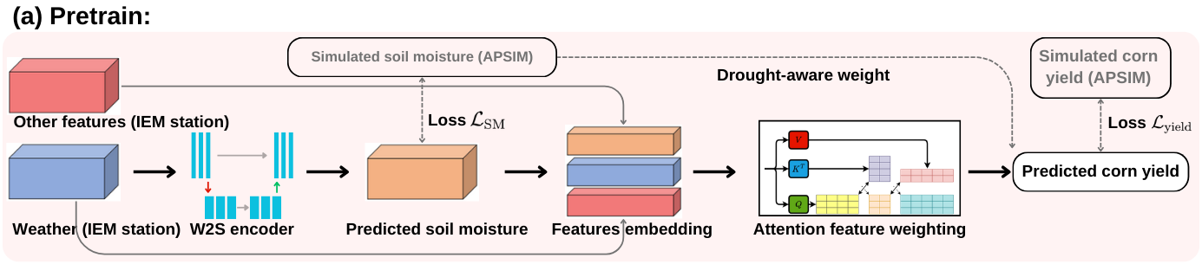
Pretrain with APSIM field-level dataset
Pretrain:
First use the APSIM field-level dataset to pretrain the model.
Notes:
This is the whole pretrain stage, we pretrain the model with the simulated dataset, the apsim field-level dataset.

Slide 28
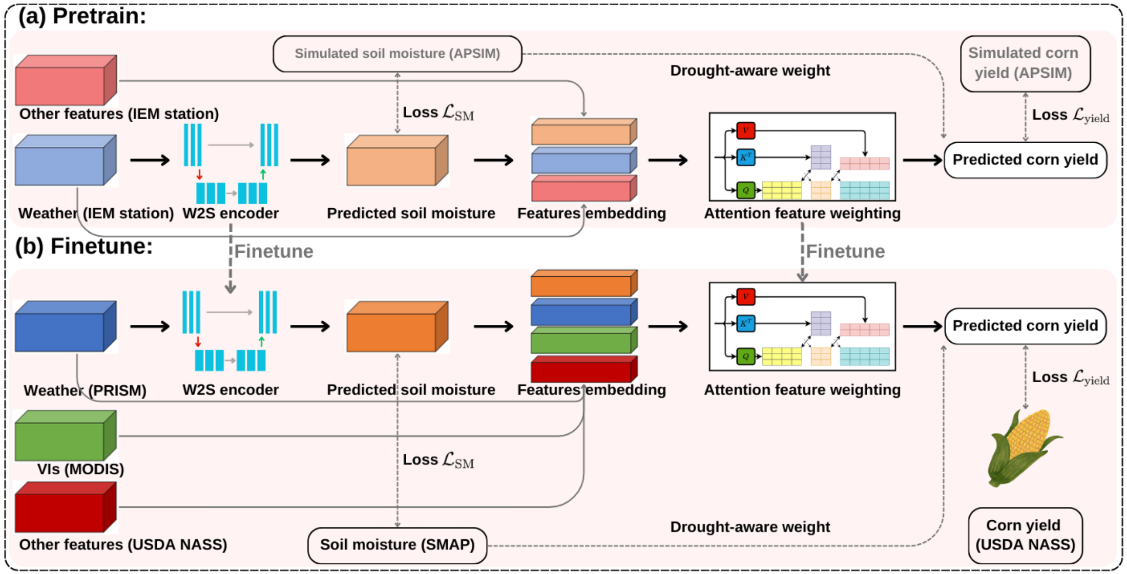
Finetune with GEE county-level dataset
Notes:
And this is the finetune stage, we finetune the model with the real dataset. The gee county-level dataset.
I use the red dash line to highlight the finetune part.
This our weather to soil encoder, we first pretrain it, then we finetune it.
This is our attention module, we first pretrain it, then we finetune it.

Slide 29
Outline
Corn yield prediction: data, method and model
Knowledge-guided machine learning (KGML)
Why, what, and how
How KGML solves problems in our task
Our method
Data acquisition: two datasets
Methodology: KGML with soil moisture model (KGML-SM)
Experiment result
Analysis
Notes:
And this the experiment result

Slide 30
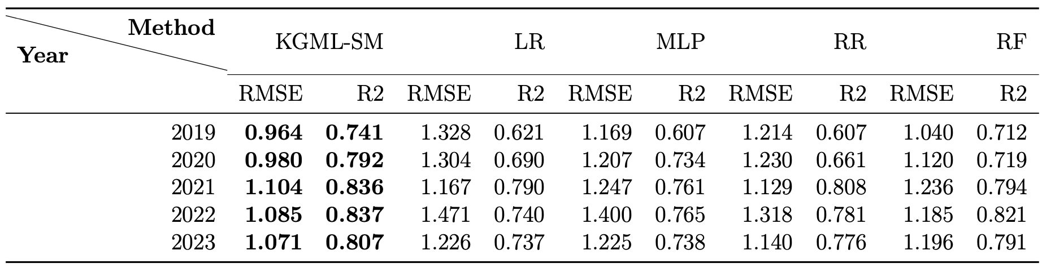
Comparison with traditional ML models
Comparison method:
Linear regression (LR), Multilayer perceptron (MLP), Ridge regression (RR) Random forest (RF)
Training year: 2015-the year preceding the test year
Testing year: 2019-2023
Notes:
First we compare our model with four traditional ml models.
The …
We can see, in all the 5 testing years, our model performs the best.

Slide 31
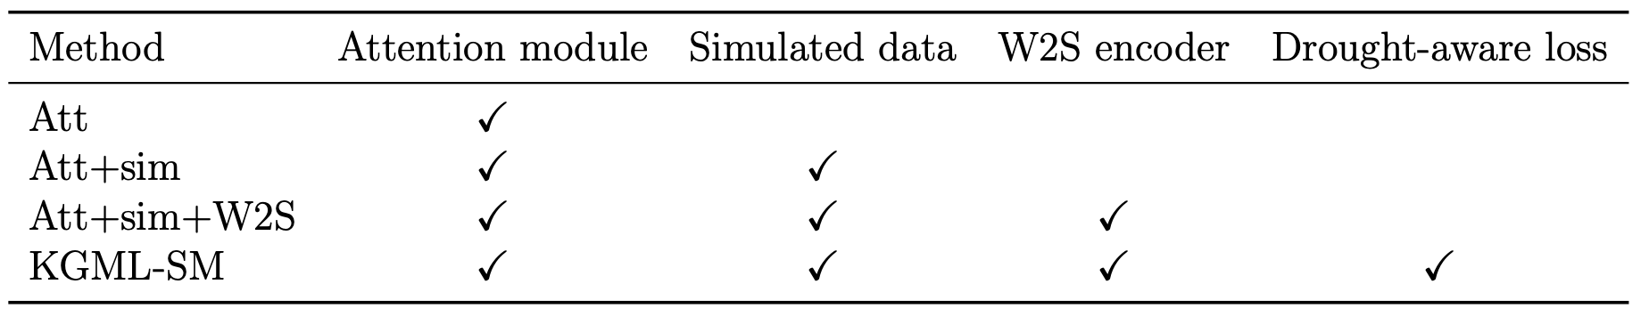
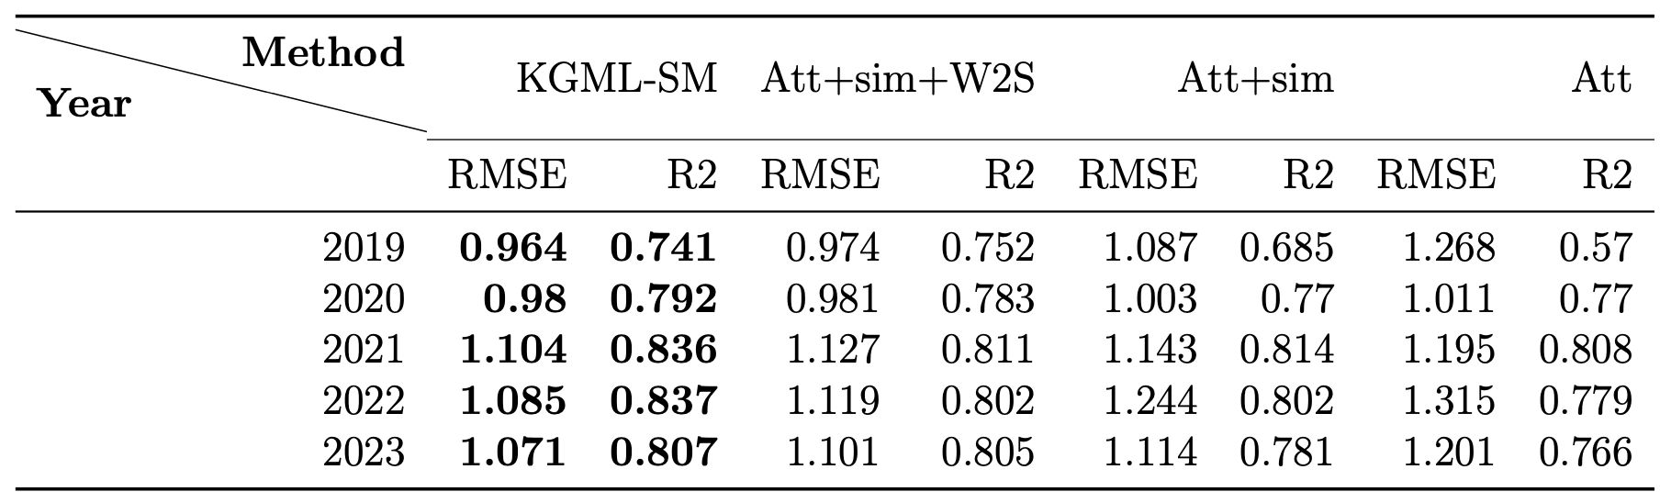
Ablation study of all the components in KGML-SM
Different components in our model:
Ablation study of different components:
Notes:
This is the ablation study.
Because there are many components in our model, we need to confirm they are all efficient.
The first table list all the components in our model. The attention module, the simualted dataset, the weather to soil encoder, and the drought aware loss function.
The second table is the result.
So from right to left, we add the components one by one to see their improvements.
… which means all the components in our model are helpful.

Slide 32
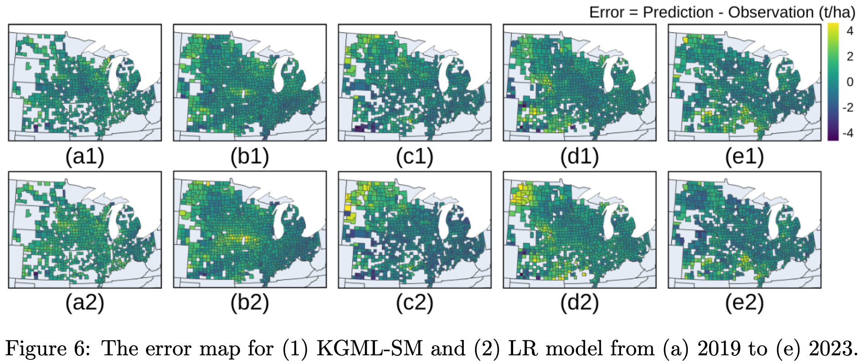
Error map in 5 years
Overestimation problem is mitigated.
Notes:
This is the error map from
The error is defined as prediction minus observation.
The first line is our kgml-sm model.
The second line is the linear regression model.
In 2019 and 2023, it's not obvious.
but in 2020, it's easy to see there is an overestimation in Iowa state.
And in 2021, an overestimation in nd, sd, and mn.
And the same as 2022. The nd.

Slide 33
Outline
Corn yield prediction: data, method and model
Knowledge-guided machine learning (KGML)
Why, what, and how
How KGML solves problems in our task
Our method
Data acquisition: two datasets
Methodology: KGML with soil moisture model (KGML-SM)
Experiment result
Analysis
Notes:
And finally we'll have some analysis

Slide 34
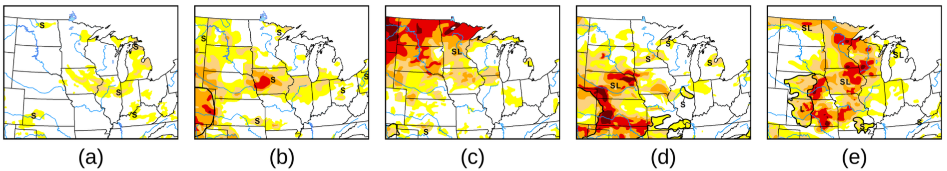
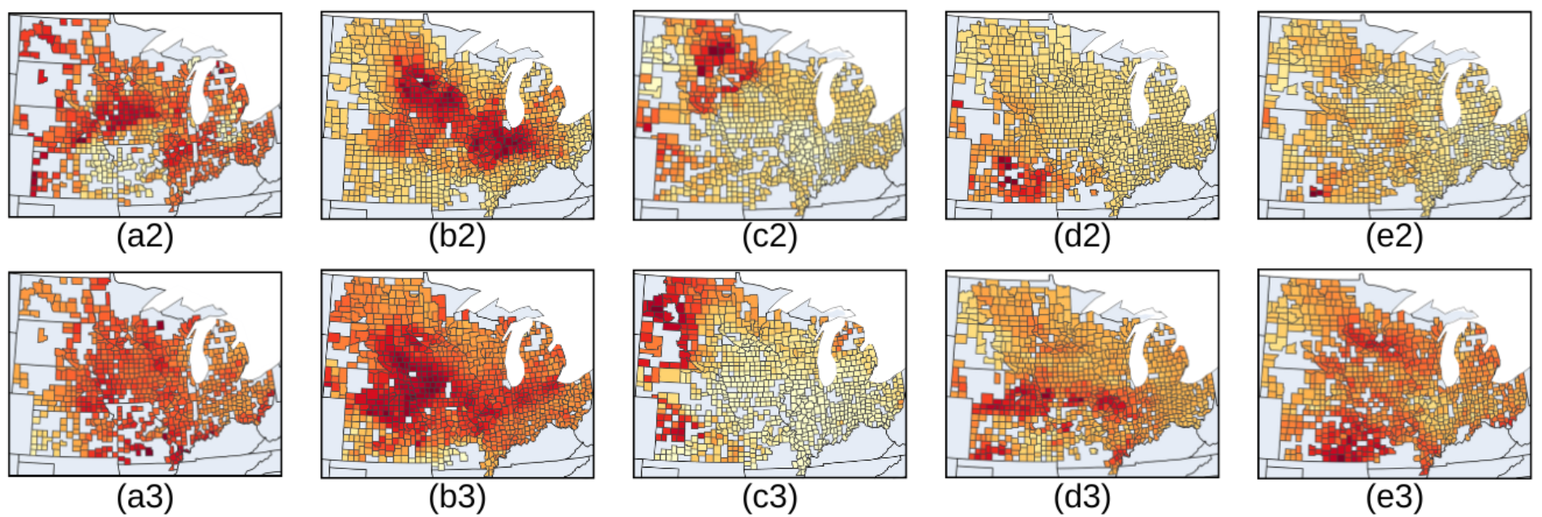
Drought map vs attention of soil moisture in 5 years
Drought map from USDA
The attention of soil moisture:​
It shows where our model "pays attention to".
Notes:
the top the drought map from usda.
The bottom is the attention visualization of soil moisture from our model, which shows where our model pay attention to.
So this map shows our model with soil moisture pay more attention to drought-affected areas.

Slide 35
Conclusion
Our model makes use of the relationship between weather, soil moisture, and corn growth to improve corn yield prediction.
We show that simulated data, the W2S encoder, and the drought-aware loss function all contribute to improving model accuracy.
Using attention visualization, we demonstrate that our model learns more from soil moisture, reducing the overestimation in drought-affected areas.

Slide 36
Thanks!

